Slide 1
Basic Web
Node Modules, MVC, Express.js, Handlebars
SoftUni Team
Technical Trainers
Software University
http://softuni.bg

Slide 2
Table of Contents
Node modules
HTTP
Create a simple HTTP Server
Express.js Framework
Model-View-Controller (MVC)
MVC with Node, Express.js, Handlebars

Slide 3
Have a Question?
sli.do
#tech-js

Slide 4
module
.exports
Node Modules
Create a Basic Web Server

Slide 5
Node Modules
A set of functions you want to include in your application
Include modules:
Create a module:
Use require to include a module
const http = require('http');
Use exports to export a module
exports.myDateTime = function () { return Date(); };

Slide 6
The HTTP Module
Built-in module, which allows Node.js to transfer data over the Hyper Text Transfer Protocol (HTTP)
Can create an HTTP server that listens to server ports and gives a response back to the client
Use the createServer() method to create an HTTP server

Slide 7
HTTP Methods
writeHead() - sends a response header to the request. Requires: status code (like 404), status message (optional) and response headers (object)
write() - sends a chunk of the response body. Can be a string or a buffer
http.createServer(function (req, res) { res.writeHead(200, {'Content-Type': 'text/html'}); res.write('Hello Web!'); res.end();
ends the response

Slide 8
Creating a Simple Web Server
Now type node {filename} and open localhost:8080 in the browser
We have to require http in order to use it
const http = require('http'); http.createServer(function (req, res) { res.writeHead(200, {'Content-Type': 'text/html'}); res.end('Hello Web!'); }).listen(8080);
console.log('Listening on port 8080');
Here we start the server
Here we choose a port

Slide 9

Express.js
Working with a Framework

Slide 10


What is ExpressJS?
Web framework for Node.js
Handles GET / POST HTTP requests
Error handling (bad request, not found, unauthorized)
Routing supported
Define URL parameters
app.post('/users/:id', function (req, res) {})

Slide 11
Installation
Create a directory to hold your application
Create a package.json file that stores dependency information
Now install express inside the directory
mkdir demoapp
cd demoapp
npm init
Saves the dependency inside package.json
npm install express --save

Slide 12
ExpressJS Routing
Refers to determining how an application responds to a client request to a particular endpoint
Express executes different functions, based on route:
Specify HTTP Request method (GET / POST)
Function to execute when the route is matched
app.get('/api/todos', function(req, res) {})
Express instance
URL (path on server)
Request & Response

Slide 13
Demo App
Create an index.js file
node index.js
const express = require('express');
const app = express();
const port = 3000;
app.get('/', function(req, res) {
res.send('Hello world!');
});
app.listen(port, () => console.log(`Example app listening on port: ${port}`));
The function handles HTTP GET requests at URL '/'

Slide 14
Handle Different HTTP Methods
Routing in express gives you the ability to handle different HTTP requests
app.post('/login', function(req, res) {})
app.put('/books/:id', function(req, res) {})
app.delete('/books/:id', function(req, res) {})

Slide 15
Working with URL Parameters
You can get a URL parameter from req.params
Chaining multiple parameters
app.get('/books/:id', function(req, res) {
let bookId = req.params.id;
console.log(bookId);
});
app.get('/user/:first/:second', function(req, res) {
console.log([req.params.first, req.params.second]);
});

Slide 16
Serving Static Files in Express
Use the express.static built-in middleware function in Express to serve static files
Create a public folder and inside store static files after that write inside index.js the following:
app.use(express.static('public'));

Slide 17
Parsing Incoming Requests
Use body parser to parse incoming request bodies available under the req.body property
npm install body-parser --save
const bodyparser = require('body-parser');
app.use(bodyparser.urlencoded({
extended: true
}));

Slide 18
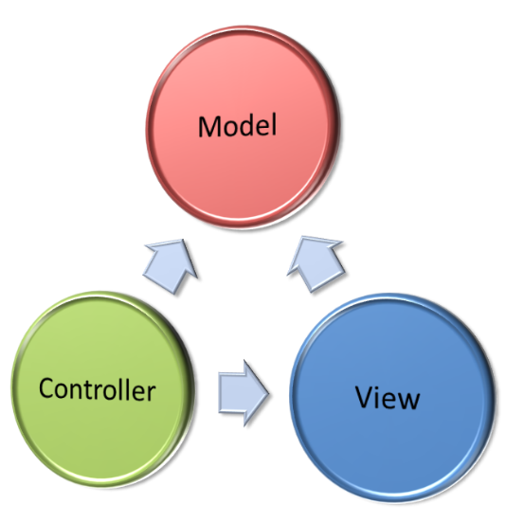
Model-View-Controller
The MVC Pattern

Slide 19
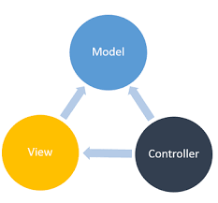
The MVC Pattern
Design pattern with three independent components
Model (data)
Manages data and database logic
View (UI)
Presentation layer (renders the UI)
Controller (logic)
Implements the application logic
Processes user request, performs an action, updates the data model and invokes a view to render some UI

Slide 20
Model (Data)
Set of classes that describes the data we are working with
Rules for how the data can be changed and manipulated
May contain data validation rules
Often encapsulates data stored in a database
As well as code used to manipulate the data

Slide 21

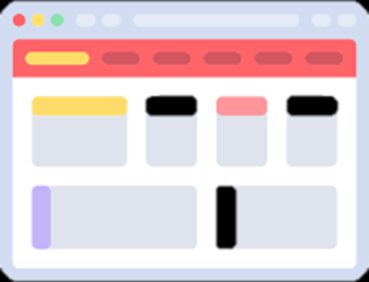

View (UI)
Defines how the application's user interface (UI) will be displayed
May support master views (layouts)
May support sub-views (partial views or controls)
May use templates to dynamically generate HTML

Slide 22

Controller (Logic)
The core MVC component – holds the logic
Process the requests with the help of views and models
A set of classes that handles
Communication from the user
Overall application flow
Application-specific logic (business logic)
Every controller has one or more "actions"

Slide 23
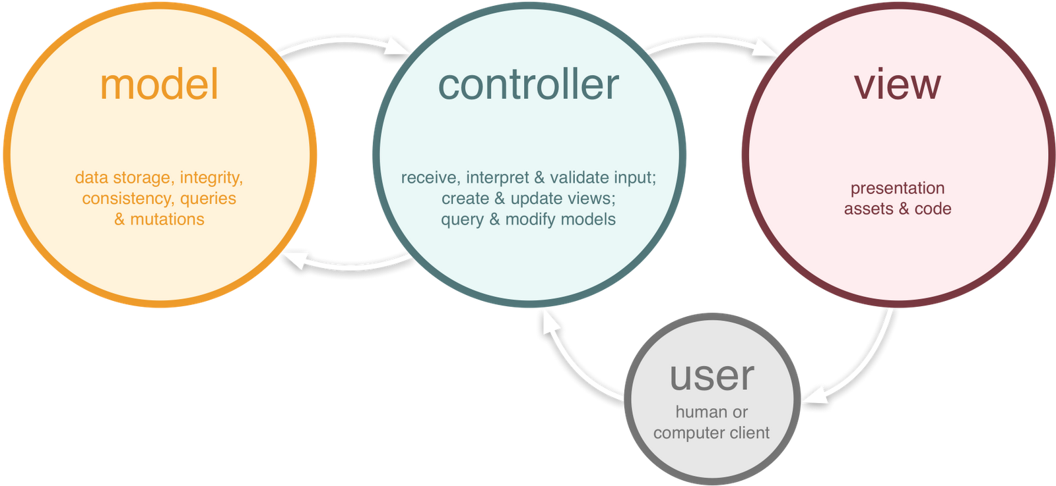
The MVC Pattern (in Web Apps)

Slide 24
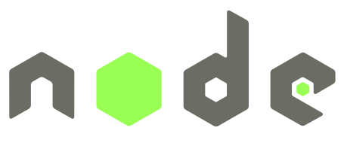

MVC with Express.js
Using Node.js, Express.js, Handlebars

Slide 25
Handlebars Templates
Handlebars provides the power necessary to let you build semantic templates effectively
It is based on the Mustache template language, but improves it in several important ways
To install it inside an Express.js project type in cmd:
npm install express-handlebars --save

Slide 26
View – Handlebars
HTML views with Handlebars templating syntax:
<div class="container body-content">
<div class="row">
<h2>{{cat.name}}</h2>
<p>Age: {{cat.age}}</p>
{{#if cat.isAlive}}
<p>Status: Alive</p>
{{else}}
<p>Status: Deceased</p>
{{/if}}
</div>
</div>
Handlebars
syntax
HTML Code
Handlebars
If/else

Slide 27
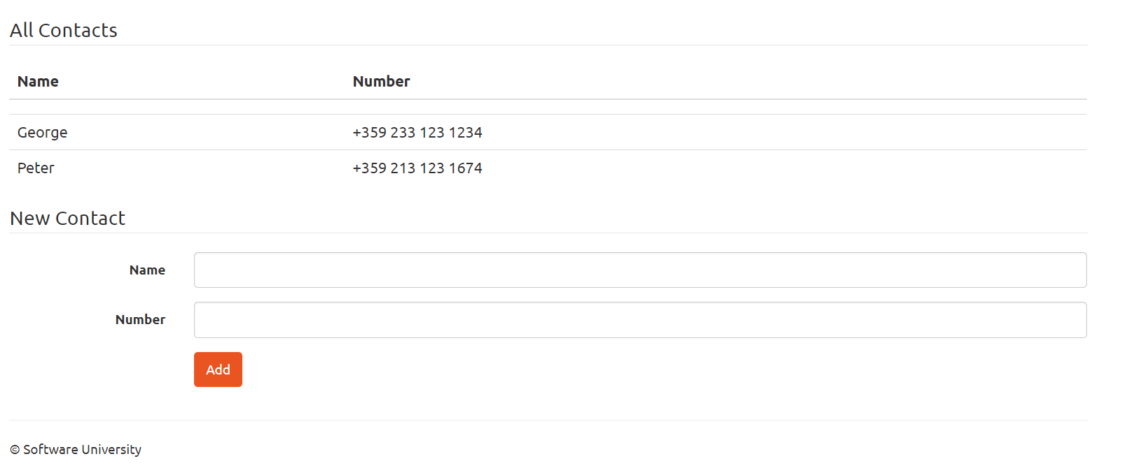
Problem: Simple Phonebook Application
Write a web application, which displays and creates contacts in a phonebook
Implement listing and adding contacts

Slide 28

Live Exercises

Slide 29
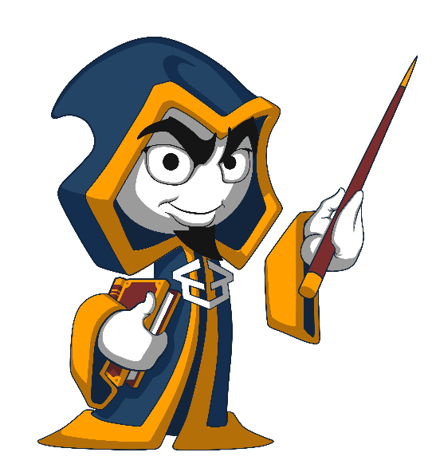
Summary
…
…
…
Node.js – JavaScript runtime environment
We use Node and HTTP to create servers
MVC is a design pattern with individual components
Express.js – Web Framework for building server-side JavaScript apps

Slide 30
https://softuni.bg/courses/technology-fundamentals

Slide 31













SoftUni Diamond Partners

Slide 32

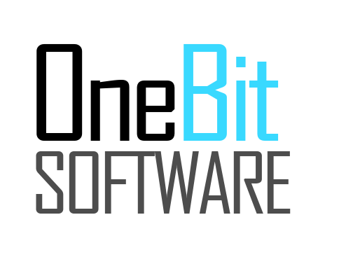


SoftUni Organizational Partners

Slide 33




Trainings @ Software University (SoftUni)
Software University – High-Quality Education and Employment Opportunities
softuni.bg
Software University Foundation
http://softuni.foundation/
Software University @ Facebook
facebook.com/SoftwareUniversity
Software University Forums
forum.softuni.bg

Slide 34

License
This course (slides, examples, demos, videos, homework, etc.) is licensed under the "Creative Commons Attribution-NonCommercial-ShareAlike 4.0 International" license

